Slide 1
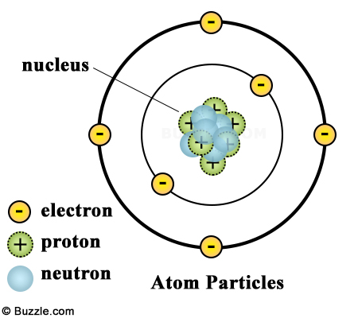
Benchmark Review - Electrostatics
Name the three subatomic particles, their location and their charge

Slide 2
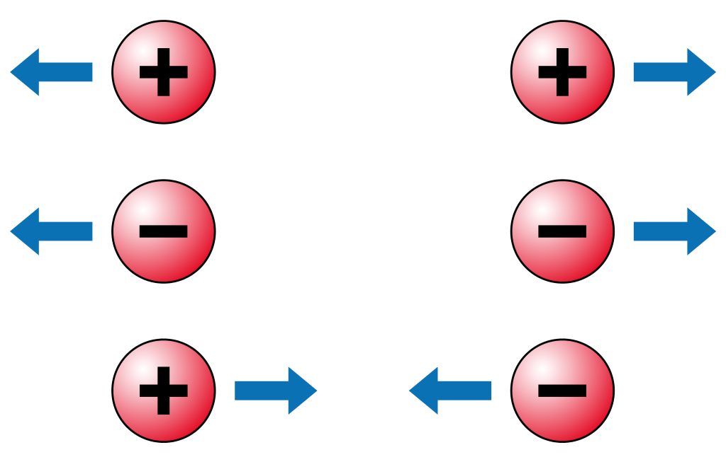
Benchmark Review - Electrostatics
What happens between two like charges? Unlike charges?

Slide 3
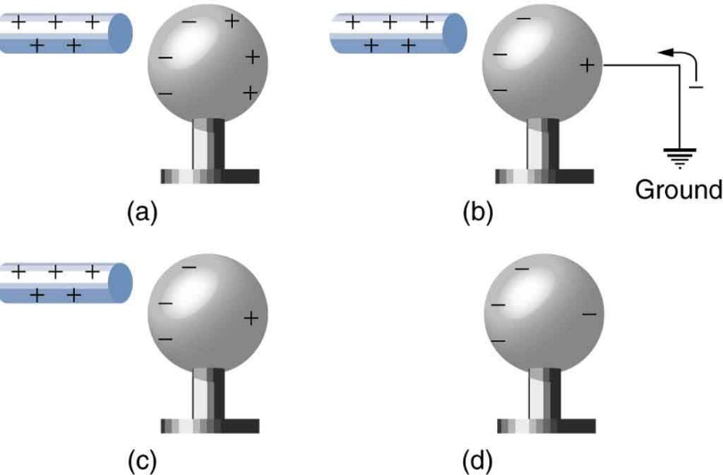
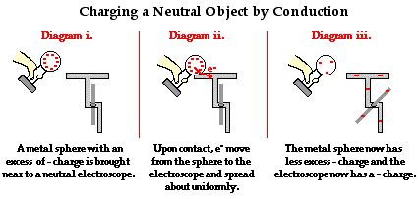
Benchmark Review - Electrostatics
List and define the three methods for charging an object.

Slide 4
Benchmark Review - Electrostatics
Compare electrical force to gravitational force and strong nuclear force.

Slide 5
Benchmark Review - Electrostatics

Slide 6
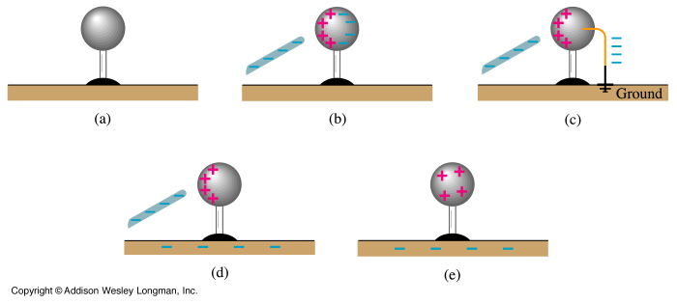
Benchmark Review - Electrostatics
Conservation of Charge

Slide 7
Benchmark Review - Electrostatics
Purpose of electroscope

Slide 8
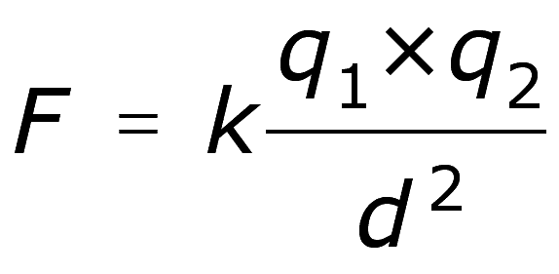
Benchmark Review - Electrostatics
Analysis of Coulomb’s Law

Slide 9
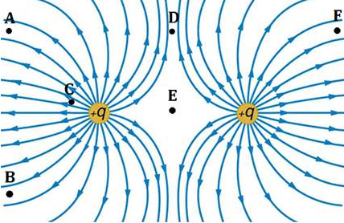
Benchmark Review - Electrostatics
Electric Fields

Slide 10
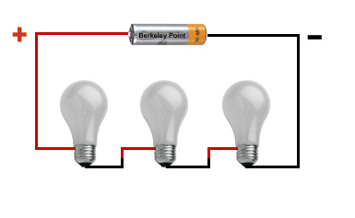
Benchmark Review - Electricity
List the characteristics of a series circuit

Slide 11
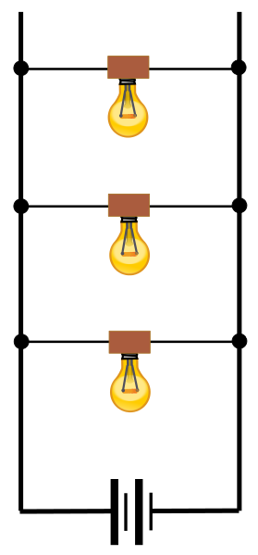
Benchmark Review - Electricity
List the characteristics of a parallel circuit

Slide 12
Benchmark Review - Electricity

Slide 13
Benchmark Review - Electricity
List the factors that affect resistance

Slide 14
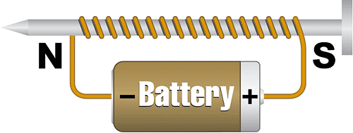
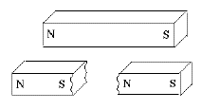
Benchmark Review - Magnetism

Slide 15
Benchmark Review - Waves
Two main categories
Types of waves in each category
Behavior exhibited by any wave

Slide 16
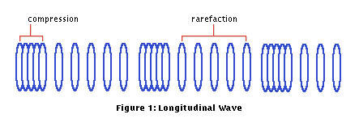
Benchmark Review - Waves

Slide 17
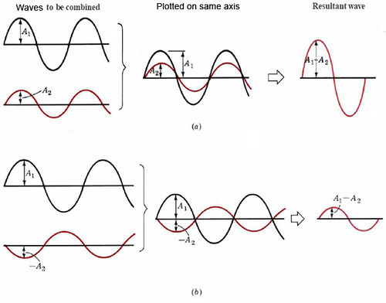
Benchmark Review - Waves
Types of Interference

Slide 18
Benchmark Review - Sound

Slide 19
Benchmark Review - Sound

Slide 20
Benchmark Review - Sound
Resonance

Slide 21
Benchmark Review - Light

Slide 22
Benchmark Review - Light

Slide 23
Benchmark Review - Light

Slide 24
Benchmark Review - Light

Slide 25
Benchmark Review – Color Addition

Slide 26
Benchmark Review – Color Subtraction

