Slide 1
Composition Notebook
9.75 x 7.50 inch sheet size
100 pages

Slide 2
Front Cover
Name
Class Period

Slide 3
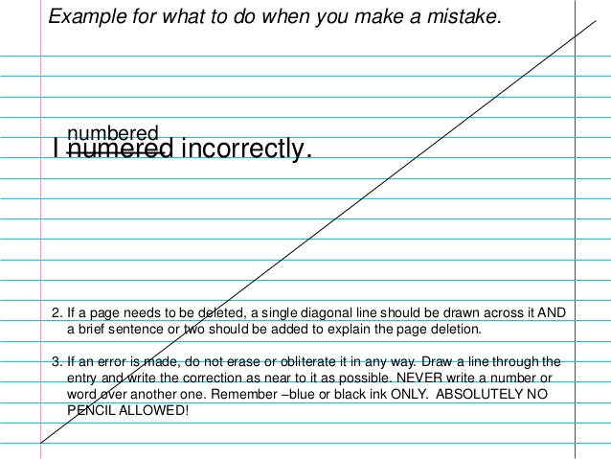
Information in Logbook
All information must be written in either blue or black ink.
Do not use White-Out.
If you make a mistake cross it out and write the correction above or below. If entire page, draw a diagonal line.

Slide 4
Page Numbers
Numbers are located on the front of each page in the upper right hand corner.
The back of each page
is not numbered but is counted.
For example, on the front of
the first page is 1, the
front of the second page is 3, the front of the third page is 5, etc.

Slide 5
First Page
Title of Project
(65 characters or less)
Your Name
Teacher’s Name
Date that you began the project (cannot be earlier than the dates on the forms)

Slide 6
Third Page
Table of Contents

Slide 7
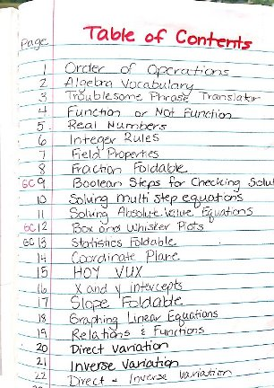
Table of Contents
Page # - do not enter these numbers until you have finished the project
Title Page
Table of Contents
Research
Dated Entries
Experimental Design
Revisions
Data
Graphs
Outline of Literature Review
Bibliography
Acknowledgements

Slide 8
Dated Entries
Date each entry.
Entries must be meaningful and you need a minimum of 2 per week beginning the week of 10-1-2018.
Example:
10-1-2018 Today I emailed Mrs. Knutson
and asked how to record a
dated entry.

Slide 9
Background Research
After the Table of Contents, the next section is for the beginning of your Background Research. Since all research is to be completed before beginning the experiment, this section should be complete for the first notebook check. Use the following format:
#1 *Number each source
Author
Title
Name of Publication (Journal or Website the article is from)
Pages cited
Website address
Exact Quotes
Other information

Slide 10
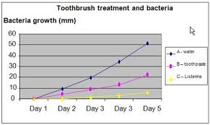
Graphs
All graphs should be computer generated and taped into the composition notebook.

Slide 11
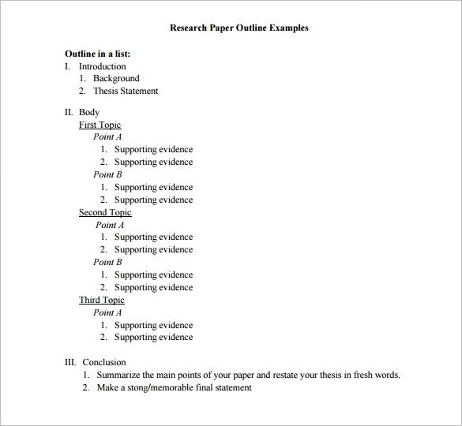
Outline of Literature Review

Slide 12
Bibliography/Works Cited
Bibliography for all sources used in literature review and project.
MLA format
Link below for sample works cited
https://owl.purdue.edu/owl/research_and_citation/mla_style/mla_formatting_and_style_guide/mla_sample_works_cited_page.html

Slide 13
Acknowledgements
In the acknowledgement section you should name and thank everyone that helped in any way throughout the project.

